Slide 1
COMP 53 – Week Seven
Big O
Sorting

Slide 2
Complete Lab 5 (if needed)

Slide 3
Topics
Big O Definition
Searching Algorithms
Sorting Algorithms

Slide 4

Why Do We Care
Programs go fast!
Faster the better
Fastest is bestest!?
Space-Time Continuum
Is Time More Important than Space?

Slide 5
Countin’ is Important
Recall algorithm definition:
Set of instructions for performing a task
Can be represented in any language
Typically thought of in "pseudocode"
Considered "abstraction" of code
Abstract Data type - "table"
Based on input size
Table called "function" in math (with arguments and return values)
Argument is input size: T(10), T(10,000), …
Function T is called "running time"

Slide 6
Counting Operations
On inputs of size N program runs for 5N + 5 time units
T(N) given by formula, such as: T(N) = 5N + 5
Must be "computer-independent"
Doesn’t matter how "fast" computers are
Can’t count "time"
Instead count "operations"

Slide 7
Counting Example
Goal – print out array values until a specific value is found
Find() function determines where in the array the value is. Assume max = 100.
int find(char arr[], char target) {
for (int i = 0; i < 100; i++)
If (arr[i] == target)
Return(i);
Return (-1);
}
void printPartial1(
char arr[], char last) {
for (int i = 0; i < find(arr, last); i++)
cout << arr[i];
}
void printPartial2(
char arr[], char last) {
int end = find(arr, last);
for (int i = 0; i < end; i++)
cout << arr[i];
}
2 operations
5 operations per loop

Slide 8
Now Let’s Do Some Math
Array Size | printPartial1 | printPartial2
0 | ? | ?
3 | ? | ?
50 | 15554 | 656
100 | 61104 | 1306
150 | 136654 | 1956
200 | 242204 | 2606
V1 = 6n² + 5n + 1→ O(n²)
V2 = 5n+2 → O(n)

Slide 9
Which One is Better?
Instructions Executed
Maximum Array Size

Slide 10
Counting Operations Example 2
int I = 0; bool found = false; while (( I < N) && !found) if (a[I] == target) found = true; else I++;
5 operations per loop iteration: <, &&, !, [ ], ==, ++
After N iterations, final three: <, &&, !
So: 6N+5 operations when target not found
Some constant "c" factor where c(6N+5) is actual running time
c different on different systems
We say code runs in time O(6N+5)
Only consider "highest term"
Term with highest exponent
➔ O(N) here

Slide 11
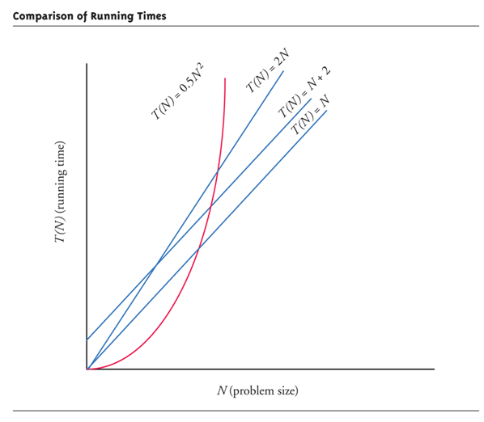
Big-O Terminology
Linear running time:
O(N)—directly proportional to input size N
Quadratic running time:
O(N²)
Logarithmic running time:
O(log N) - "log base 2"
Very fast sort algorithms!
Exponential running time
O(2^{N})
Chess and gaming algorithms

Slide 12
Sorting is Expensive
Faster on smaller input set?
Perhaps
Might depend on "state" of set
"Mostly" sorted already?
Consider worst-case running time
T(N) is time taken by "hardest" list
List that takes longest to sort

Slide 13
Standard Template Running Times
O(1) - constant operation always:
Vector inserts to front or back
deque inserts
list inserts
O(N)
Insert or delete of arbitrary element in vector or deque (N is number of elements)
O(log N)
set or map finding

Slide 14
Topics
Big O Definition
Searching Algorithms
Sorting Algorithms

Slide 15
Return Midterms
Review key problems

Slide 16
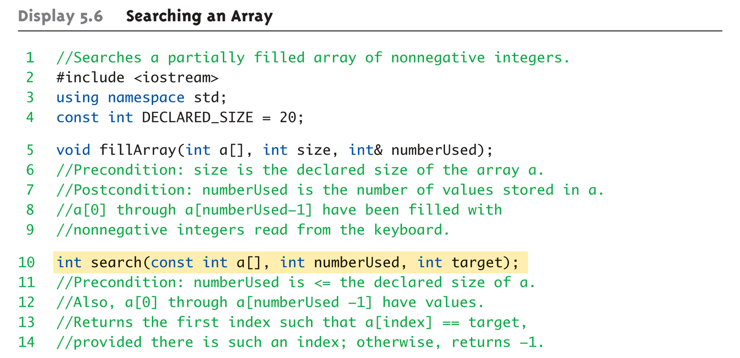
Searching an Array (1 of 4)

Slide 17
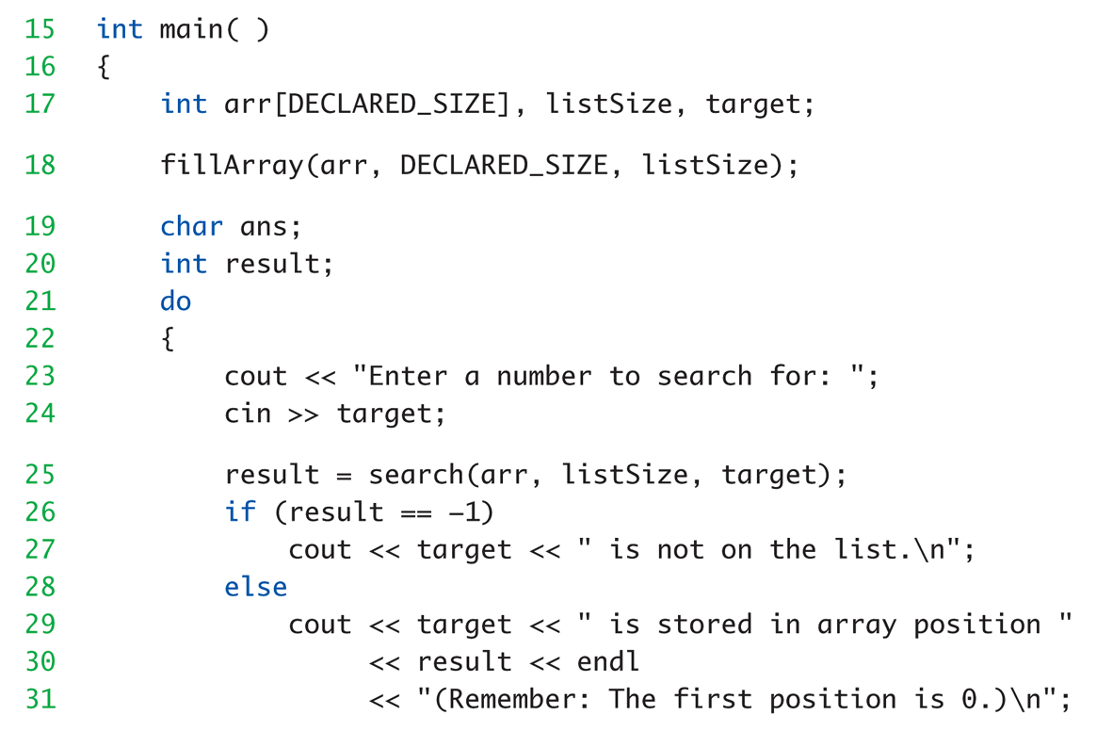
Searching an Array (2 of 4)

Slide 18
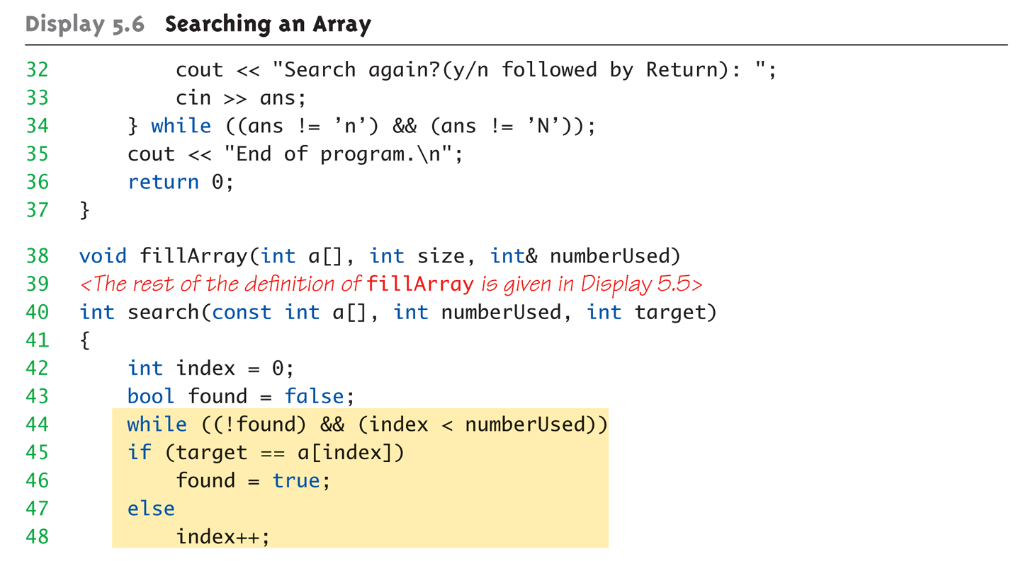
Searching an Array (3 of 4)
Data type could be changed to template <class T>

Slide 19
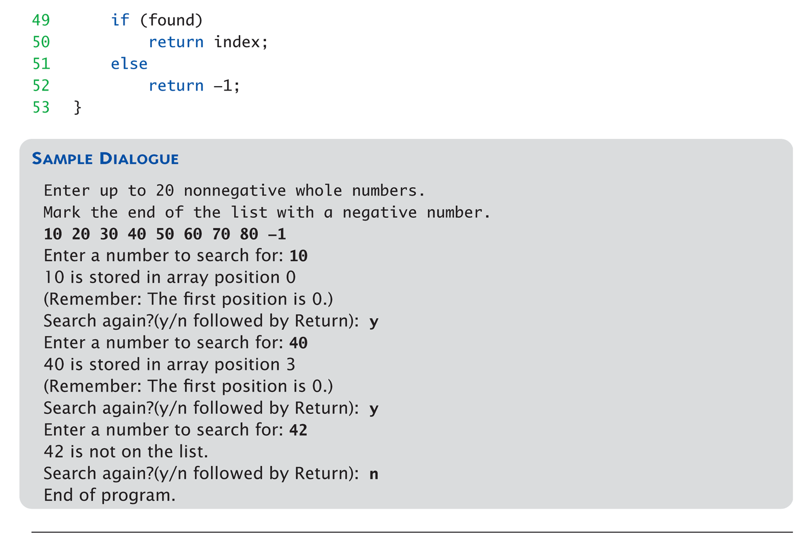
Searching an Array (4 of 4)
What Oh is this search?

Slide 20
Can We Go Faster! You Betcha!!!
In pervious example, search started at beginning of array
Is this required
Think about divide and conquer
What If… Array is already sorted?
Think about a phone book search – where do you start?
How is the data divided
AKA – Binary Search
Back to our old friend - Recursion

Slide 21
Binary Search Template
template <class T>
int binarySearch(T arr[], T item, int start, int end) {
int mid = (start + end) / 2;
if (arr[mid] == item)
return mid;
else if (start >= end)
return -1;// NOT found
if (arr[mid] < item)
return binarySearch(arr, item, mid + 1, end);
return binarySearch(arr, item, start, mid - 1);
}
Recursive call to split the problem in two

Slide 22
Topics
Big O Definition
Searching Algorithms
Sorting Algorithms

Slide 23
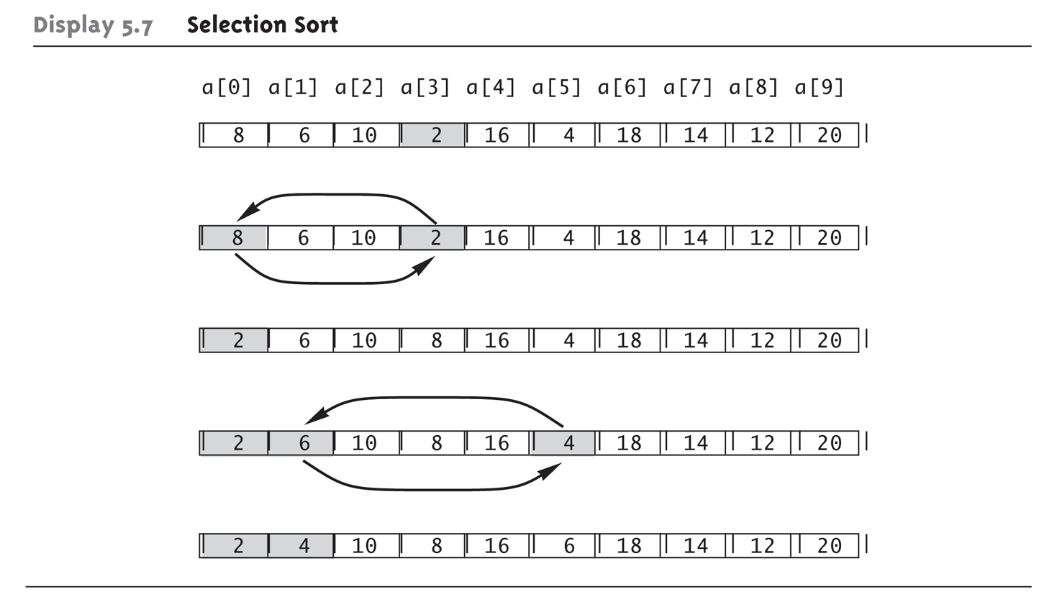
Sorting an Array Selection Sort Algorithm
Find the smallest value in the array.
Swap with first element
Move to next element, find smallest value in remainder

Slide 24
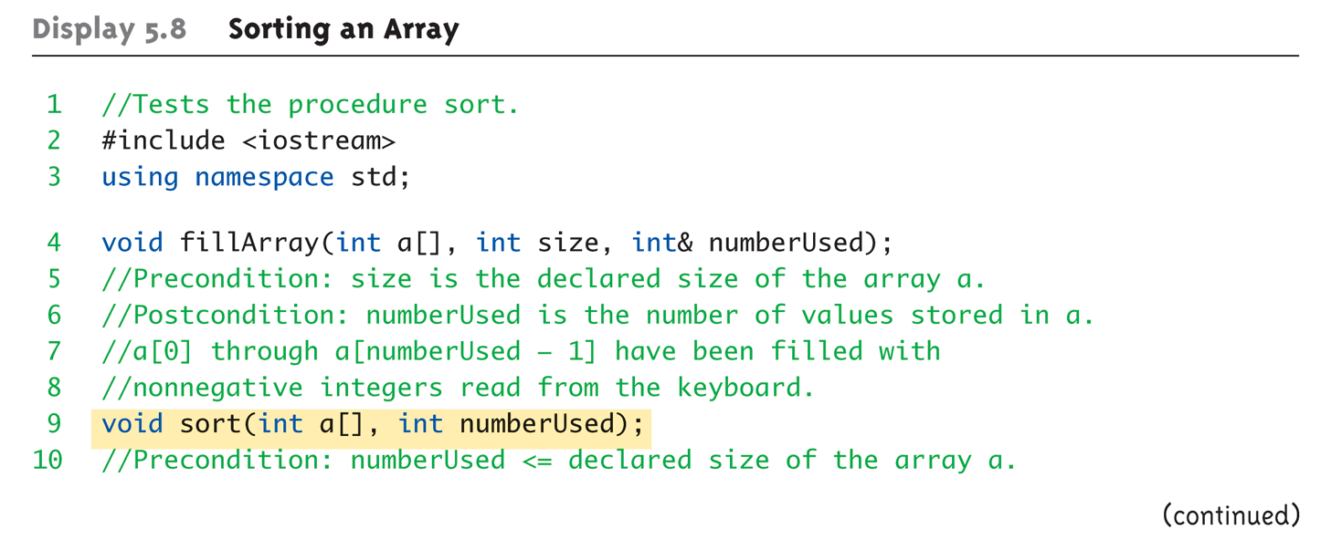
Selection Sort (1 of 4)
Again – int can be replaced with Template

Slide 25
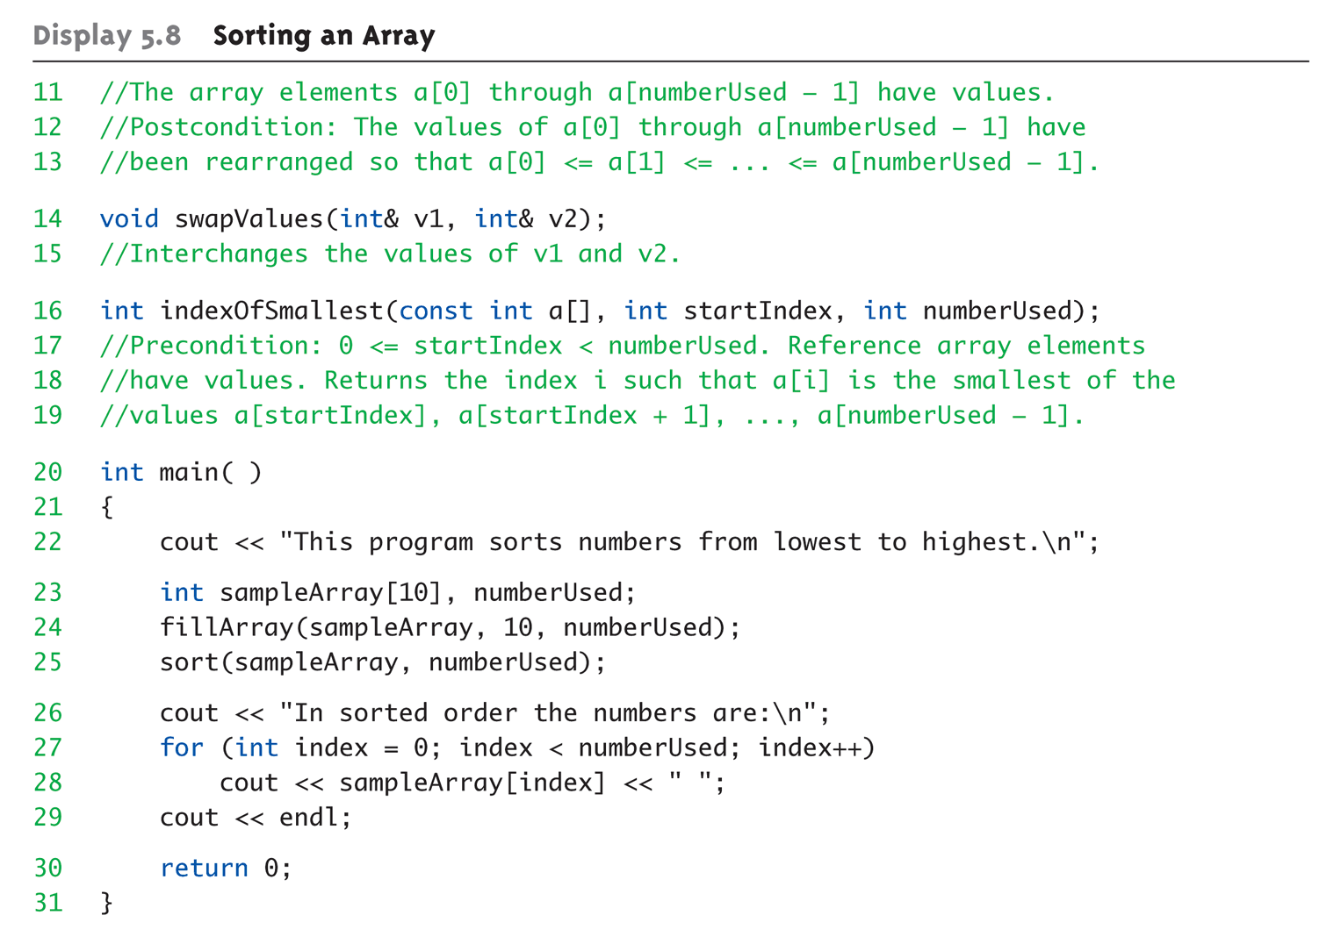
Selection Sort (2 of 4)

Slide 26
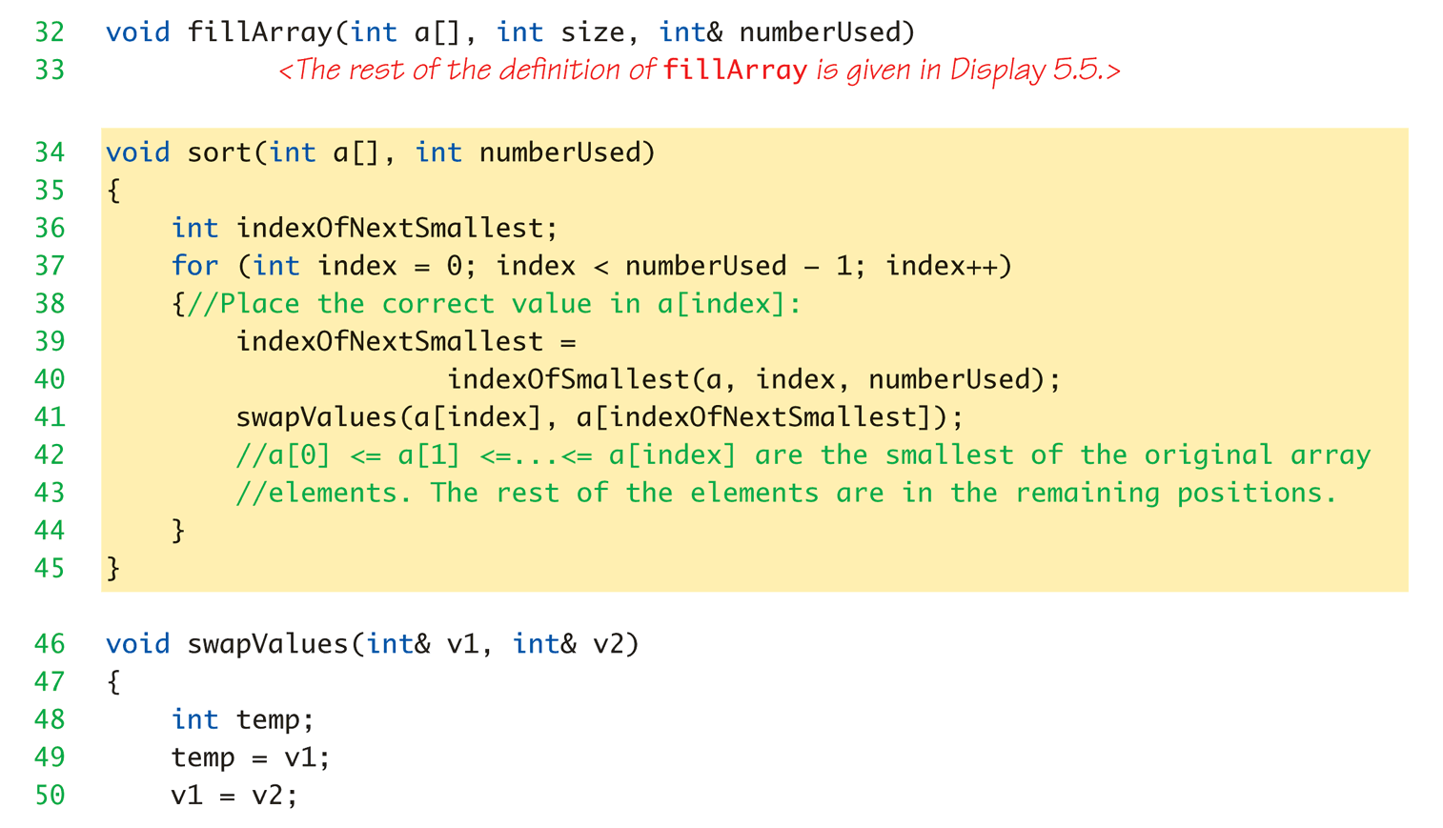
Selection Sort (3 of 4)
What O(h) is sort()?
What O(h) is Swap?

Slide 27
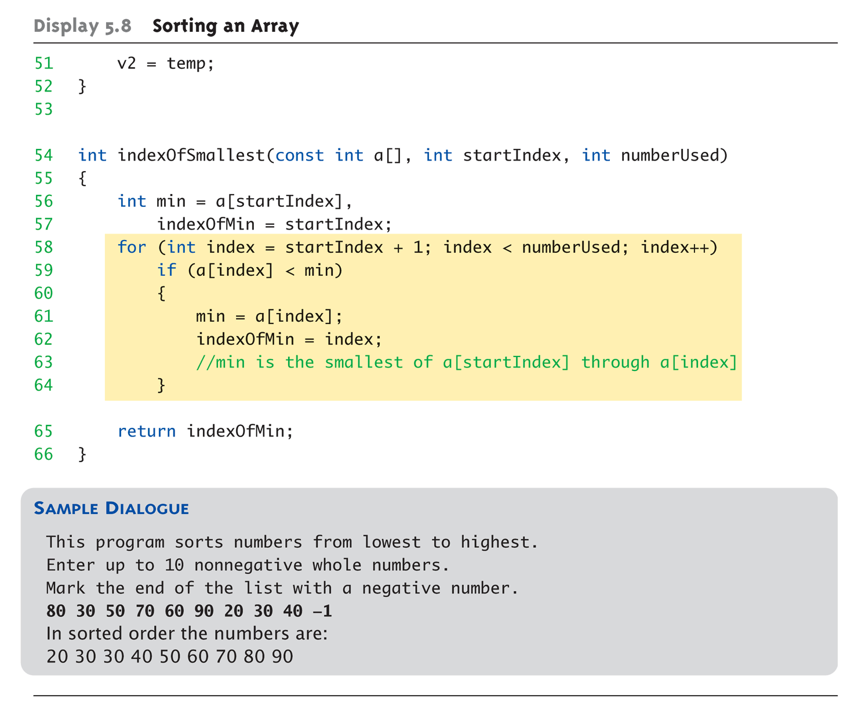
Selection Sort (4 of 4)
What O(h) is indexOfSmallest?
What O(h) is total sort?
Need to trace

Slide 28
In Class Exercise
Who’s the shortest?
Who’s the tallest?

Slide 29
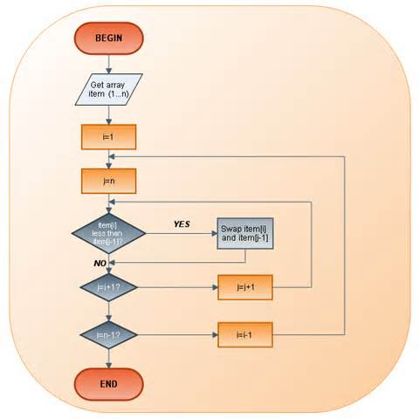
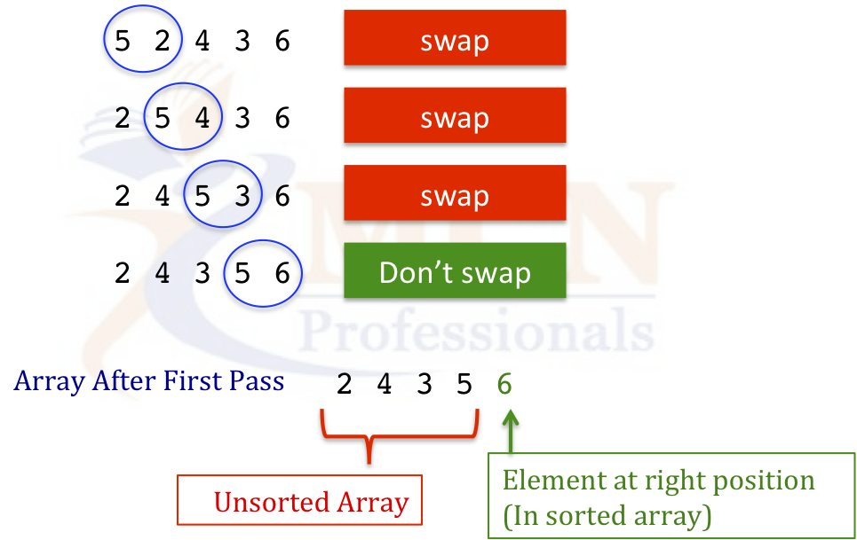
Bubble Sort Option Animation

Slide 30
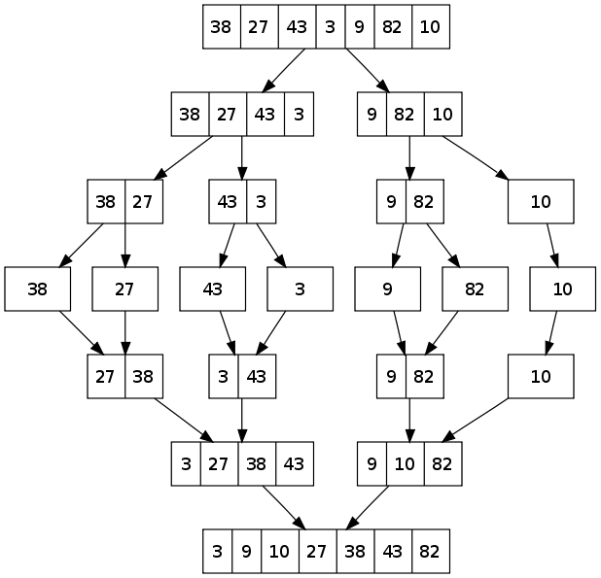
Other Sort Algorithms mergeSort()
Approach
Break array into halves until size = 1
Merge sublists together so that they are sorted
Typically recursive solution
O(n log n) performance
Extra space needed due to recursion and temporary arrays

Slide 31
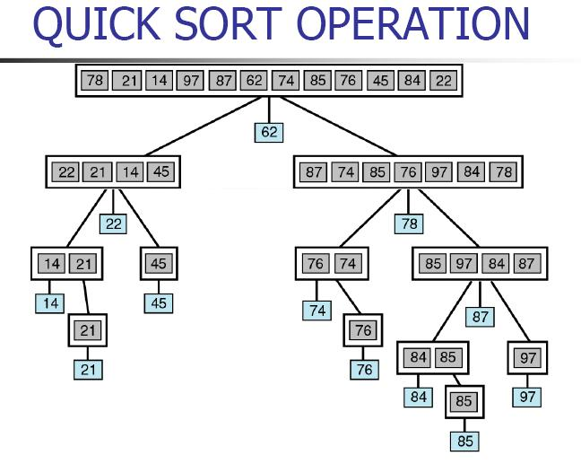
Other Sort Algorithms quickSort()
Approach
Find the middle value in the set such that all values to left are smaller and to the right are bigger
Recursively sort each side
Also O(n log n) performance
O(n) extra storage space required
Middle is called the pivot point

Slide 32
Sort Animations Let Your Inner Geek Out
Check out sorts in action
https://www.youtube.com/watch?v=t8g-iYGHpEA
Interactive Sorting Tool
https://www.cs.usfca.edu/~galles/visualization/ComparisonSort.html

Slide 33
O(h) Summary for n = 1024
Performance Metric | Name | N=100
O(1) | Constant | 1
O(n) | Linear | 6.64
O(log n) | Logarithmic | 100
O(n log n) | Log-linear | 664
O(n²) | quadratic | 10000
O(n³) | cubic | 100000
2^{n} | exponential | 1270000000000000000
N! | factorial | More than a lifetime

Slide 34
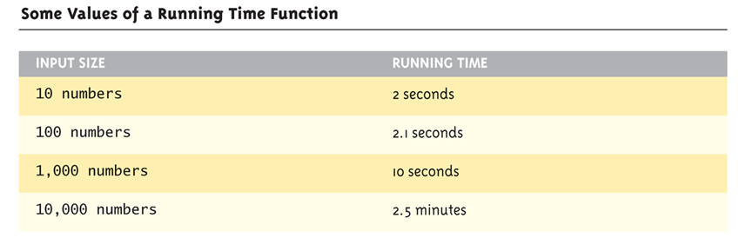
Table for Running Time Function: Display 19.15 Some Values of a Running Time Function

Slide 35
Efficiency
STL designed with efficiency as important consideration
Strives to be optimally efficient
Example: set, map elements stored in sorted order for fast searches
Template class member functions:
Guaranteed maximum running time
Called "Big-O" notation, an "efficiency"-rating

Slide 36
Nonmodifying Sequence Algorithms
Template functions operating on containers
NO modification of container contents
Generic find function
Typical example
Can be used with any STL sequence container class

Slide 37
Display 19.17 The Generic find Function (1 of 3)
1 //Program to demonstrate use of the generic find function.
2 #include <iostream>
3 #include <vector>
4 #include <algorithm>
5 using std::cin;
6 using std::cout;
7 using std::endl;
8 using std::vector;
9 using std::find;
10 int main( )
11 {
12 vector<char> line;
13 cout << "Enter a line of text:\n";
14 char next;
15 cin.get(next);
16 while (next != ’\n’)
17 {
18 line.push_back(next);
19 cin.get(next);
20 }

Slide 38
Display 19.17 The Generic find Function (2 of 3)
21 vector<char>::const_iterator where;
22 where = find(line.begin( ), line.end( ), ’e’);
23 //where is located at the first occurrence of ’e’ in v.
24 vector<char>::const_iterator p;
25 cout << "You entered the following before you entered your
first e:\n";
26 for (p = line.begin( ); p != where; p++)
27 cout << *p;
28 cout << endl;
29 cout << "You entered the following after that:\n";
30 for (p = where; p != line.end( ); p++)
31 cout << *p;
32 cout << endl;
33 cout << "End of demonstration.\n";
34 return 0;
}
If find does not find what it is looking for, it returns its second argument.

Slide 39
Display 19.17 The Generic find Function (3 of 3)
Sample Dialogue 1
Enter a line of text
A line of text.
You entered the following before you entered your first e:
A lin
You entered the following after that:
e of text.
End of demonstration.
Sample Dialogue 2
Enter a line of text
I will not!
You entered the following before you entered your first e:
I will not!
You entered the following after that:
End of demonstration.

Slide 40
Modifying Sequence Algorithms
STL functions that change container contents
Recall: adding/removing elements from containers can affect other iterators!
list, slist guarantee no iterator changes
vector, deque make NO such guarantee
Always watch which iterators are assured to be changed/unchanged

Slide 41
Set Algorithms
STL generic set operation functions
All assume containers stored in sorted order
Containers set, map, multiset, multimap
DO store in sorted order, so all set functions apply
Others, like vector, are not sorted
Should not use set functions

Slide 42
Sorting Algorithms
STL contains two template functions:
sort range of elements
merge two sorted ranges of elements
Guaranteed running time O(N log N)
No sort can be faster
Function guarantees fastest possible sort

Slide 43
Key Takeaways
Big ‘O’ notation
Indicates the relative performance of an algorithm
Based on the size of the problem trying to solve
Fastest search has _______________ speed
Fastest sort has _______________ speed
Speed vs Space
Sometimes using more space becomes slower than wasting execution time.

